Slide 1
Sudoku Solver
Michel de Beijer
Mike van laar

Slide 2
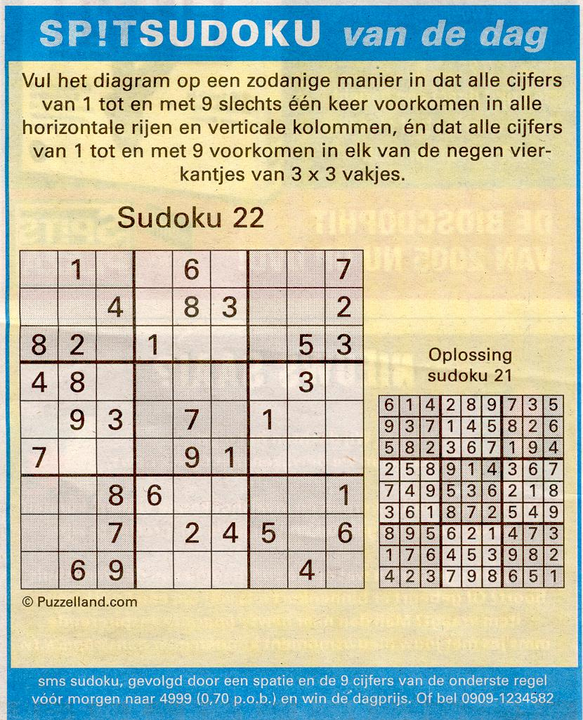
De opdracht
Sudoku problem by brute force
Write a program to solve Sudoku puzzles. Use brute force!
Describe how your algorithm works, using natural language or pseudocode. Note that a Brute Force algorithm for this problem is usually (but not necessarily) also a backtrack algorithm.
- Give sound reasoning that will show that the algorithm is guaranteed to terminate, and what the possible results are.
- Select a suitable data structure for the puzzles.
- Implement and test your algorithm.

Slide 3
solve 1/2
public void solve(int[][] puzzle, int row, int col)
{
if (row > puzzle.Length - 1)
{
Console.WriteLine("Solution Found:");
displayGrid(puzzle);
return;
}
if (puzzle[row][col] != 0)
{
next(puzzle, row, col);
}

Slide 4
solve 2/2
else
{
for (int num = 1; num < puzzle.Length + 1; num++)
{
if (checkRow(puzzle, row, num) && checkCol(puzzle, col, num) &&
checkBox(puzzle, row, col, num))
{
puzzle[row][col] = num;
next(puzzle, row, col);
}
}
puzzle[row][col] = 0;
}

